Slide 1

Insights from NASSCOM AI Developer Workshop
Key Takeaways and Future Directions in AI

Slide 2

Math for AI: Essential Foundations
Linear Algebra
Vectors, matrices, tensors, eigen vectors/values, SVD, and principal component analysis
Calculus
Derivatives, vector/matrix calculus, and gradient algorithms
Statistics & Probability
Basic stats, probability rules, random variables, Bayes theorem, and maximum likelihood estimation
Information Theory
Entropy, cross entropy, KL divergence, Viterbi algorithm, and encoder-decoder algorithms

Slide 3

PyTorch: Leading Deep Learning Framework
Essential PyTorch Knowledge
Tensor fundamentals and operations
PyTorch workflow and training loops
Neural network classification
Computer vision applications
Transfer learning techniques
Model deployment strategies
Popular resources: YouTube tutorial and PyTorch official tutorials

Slide 4




Computer Vision: From Pixels to Perception
What Is It?
Core Techniques
Process
Enabling computers to interpret digital images and videos, automating tasks that the human visual system performs—recognition, detection, and tracking.
Image classification, object detection, segmentation, and feature extraction for tasks like image stitching or 3D reconstruction.
Data collection, preprocessing, modeling with traditional or deep learning methods, training, validation, and deployment.

Slide 5




Computer Vision Applications
Autonomous Vehicles
Medical Imaging
Surveillance & Security
Industrial Automation
Lane detection and object recognition for self-driving cars
Tumor detection, pathology and radiology analysis
Face recognition and monitoring systems
Quality control and robotics applications

Slide 6
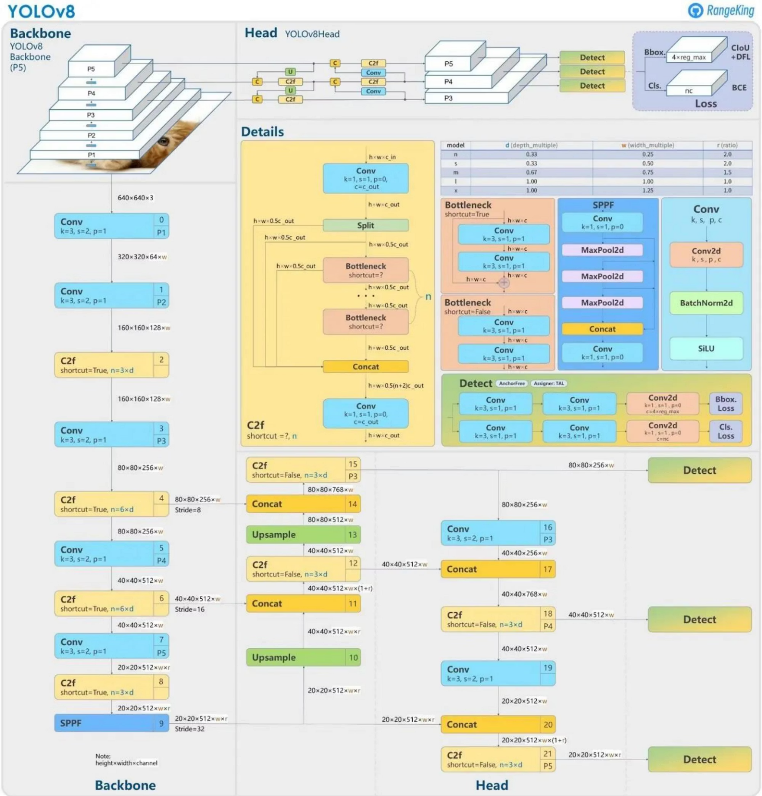
YOLO: You Only Look Once
Key Features
Real-time object detection model family
Unified detection network predicting bounding boxes and class probabilities directly
Improved accuracy and speed over previous versions
Streamlined architecture suitable for real-time applications
Architecture Overview
Backbone: CSP or lightweight architectures
Neck: FPN or PAN for feature map combination
Prediction Heads: Separate layers for classification and bounding box regression
Key Innovations
Spatial attention for precise object localization
Feature fusion for improved small object detection
Bottlenecks and SPPF for reduced computational complexity
Open-source and community-driven development

Slide 7

Large Language Models: The Frontier AI Today
Proprietary Models
Open-Source Models
Open Models
GPT-4, Claude 3 Opus
OLMo, Falcon, Dolly
LLAMA 2/3, Mistral, ChatGLM
Available via paid APIs or web interfaces on cloud
Completely open pre-training code, evaluation code and model weights
Apache 2 License with models and weights openly available

Slide 8

Llama 4: Leading Multimodal Intelligence
1
Key Innovations
Mixture of experts (MoE) architecture for compute efficiency
Llama 4 Scout
Native multimodality with early fusion
17B active parameters with 16 experts (109B total)
Improved vision encoder based on MetaCLIP
Industry-leading 10M context length
Advanced training techniques including MetaP
Comprehensive safeguards and bias mitigations
Optimized for inference efficiency
2
Llama 4 Maverick
17B active parameters with 128 experts (400B total)
Native multimodal with 1M context length
Beats GPT-4o and Gemini 2.0 Flash on multiple benchmarks
3
Llama 4 Behemoth
288B active parameters with 16 experts (2T total)
Teacher model for distillation
Outperforms GPT-4.5, Claude Sonnet 3.7, and Gemini 2.0 Pro on STEM benchmarks

Slide 9






Agentic AI: Building Autonomous Systems
Agentic AI empowers systems to act intelligently and autonomously towards defined goals.
Autonomous Action
Goal-Oriented
AI agents can make decisions and execute actions independently, without constant human oversight.
They are designed to achieve specific objectives, often breaking down complex tasks into smaller, manageable steps.
Environmental Awareness
Learning & Adaptation
Agents perceive their environment, process information, and react to changes, adapting their behavior as needed.
They can learn from interactions and past experiences, continuously improving their performance and decision-making over time.

Slide 10






Agentic AI: Implementation & Data Engineering Use Cases
Implementing Agentic AI
Building intelligent agents involves integrating several core components for autonomous operation:
Reasoning & Planning
Utilize LLMs or symbolic AI for task decomposition, goal setting, and strategic execution pathways.
Tool Use & Action
Enable agents to interact with external systems like databases, APIs, and data processing frameworks (e.g., Spark, Airflow).
Memory Management
Implement short-term context (scratchpad) and long-term knowledge bases (vector databases) for continuous learning and retrieval.
Perception & Monitoring
Allow agents to observe data streams, pipeline logs, and system metrics to understand the current state and detect changes.
Use Cases in Data Engineering
Agentic AI offers transformative potential for optimizing data workflows:
Automated Pipeline Management: Self-healing data pipelines that detect and resolve issues proactively.
Intelligent Data Quality: Real-time anomaly detection, validation, and automated correction of data inconsistencies.
Dynamic Resource Optimization: Agents adaptively scale compute resources for ETL jobs based on workload and performance metrics.
Automated Data Discovery: Smart agents can identify, catalog, and suggest new data sources or transformations based on business needs.

